Slide 1
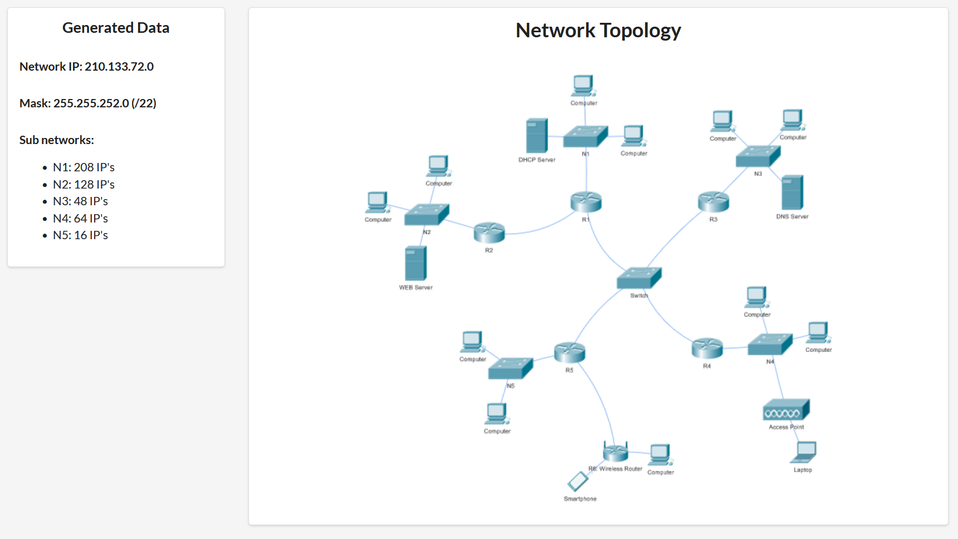

Slide 2
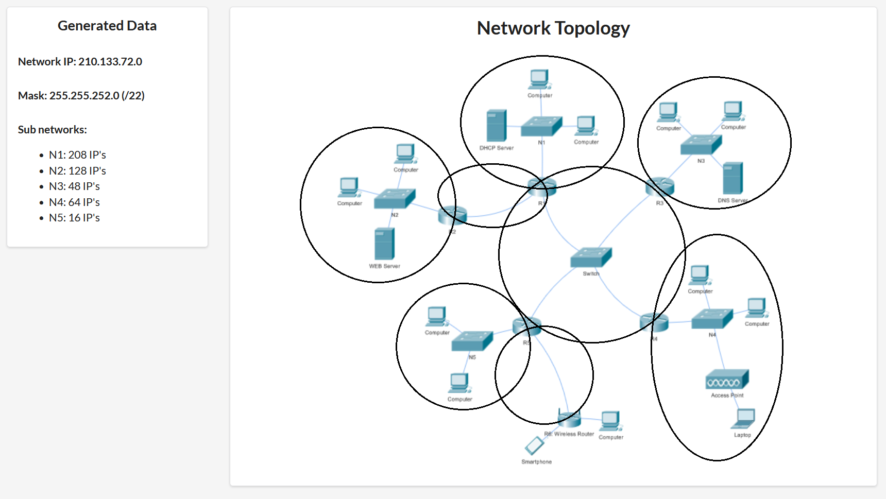
X = 32 – 22 = 10; 2^10 = 1024
Additional networks:
N1345: 4 IP
N12: 2 IP
N5w: 2 IP

Slide 3
/22 => 1024 IP addresses
n devices (IP) + 1 router + 1 NA + 1 BA => n + 3
N1: 208 + 3 = 211 < 256 = 2^8 8 zeros, 32 – 8 = 24 ones /24
N2: 128 + 3 = 131 < 256 = 2^8 /24
N3: 48 + 3 = 51 < 64 = 2^6 /26
N4: 64 + 3 = 67 < 128 = 2^7 /25
N5: 16 + 3 = 19 < 32 = 2^5 /27
N1345: 4 + 2 < 8 = 2^3 /29
N12: 2 + 2 < 4 = 2^2 /30
N5w: 2 + 2 < 4 = 2^2 /30
256 + 256 + 64 + 128 + 32 + 8 + 4 + 4 = 752 < 1024
We have 1024 – 752 = 272 unused IP addresses.

Slide 4
Recursive network split using a binary tree
/22
/23
/24
/25
/26
/27
/28
/29
/30
1024
512
512
256
256
256
256
128
128
64
64
32
32
16
16
8
8
4
4
N1=256, N2=256 , N4=128, N3=64, N5=32, N1345=8, N12=4, N5w=4

Slide 5
Recursive network split using intervals
210.133.72.0/22
[0…………………………………………………………………………………………………………………….………………………………………………..1023]
[0…………………………………............................................…511][512……………………………………..………………………………….1023]
[0…………………………….…..255][256……….…….………...511][512…………………………………..767][768……….………………1023]
[0……………….………………..255][256……………..………...511][512……….…639][640….…....767][768…………….…………1023]
[640…...……..703][704………………………………………………………………………………………………………………………………………...767]
[640…...……..703][704………….735][736…………………………………………………………………………………………………………..….767]
[640…...……..703][704………….735][736………………………………………..…….751][752 ……………………………………..…..…..767]
[640…...……..703][704………….735][736.....743][744……………………...…..751][752……………………………………………….767]
[640…...……..703][704………….735][736…..743][744.…...747][748.…….751][752…………………………..……………….….767]
NA and BA

Slide 6
Enumerating the networks for 210.133.72.0/22
N1 = 210.133.72.0/24 (255.255.255.0) R1 = .1 S1 = .2
N2 = 210.133.73.0/24 (255.255.255.0) R2 = .1 S2web = .2
N4 = 210.133.74.0/25 (255.255.255.128) R4 = .1
N3 = 210.133.74.128/26 (255.255.255.192) R3 = .129 S3dns = .130
N5 = 210.133.74.192/27 (255.255.255.224) R5 = .193
N1345 = 210.133.74.224/29 (255.255.255.248) R1 = .225 R3 = .226 R4 = .227 R5 = .228
N12 = 210.133.74.232/30 (255.255.255.252) R1 = .233 R2 = .234
N5w = 210.133.74.236/30 (255.255.255.252) R1 = .237 Rw = .238

Slide 7
